Slide 1
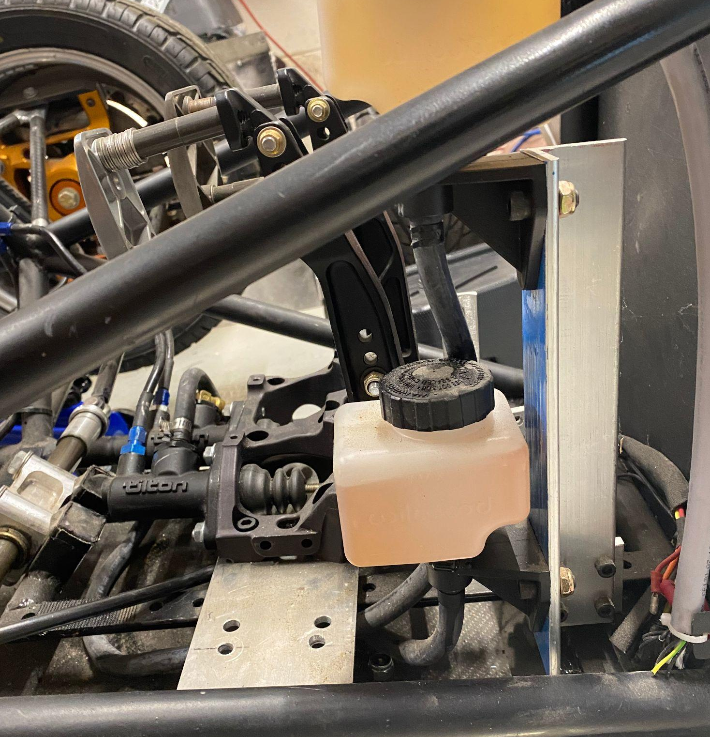
ENGINEERING
DIGITAL
PORTFOLIO
KRISTEN UMBRIAC
Braking system components on the 2020 Princeton Racing Electric vehicle

Slide 2
MATLAB PROJECT EXAMPLE
TABLE OF CONTENTS
01
LATEX REPORT EXCERPT
02
CREO CANTILEVERED WING (DESIGN, FEA, DRAWINGS)
03
PRINCETON RACING ELECTRIC
04
PRINCETON UNIVERSITY BALLET
05
A short program from a Mechanics of Fluids Lab
Pages from a fall semester Thermodynamics Lab report
Final team project for my Engineering Design course
My accomplishments as Brake System Lead
My love! What I’ve accomplished as Production Manager

Slide 3

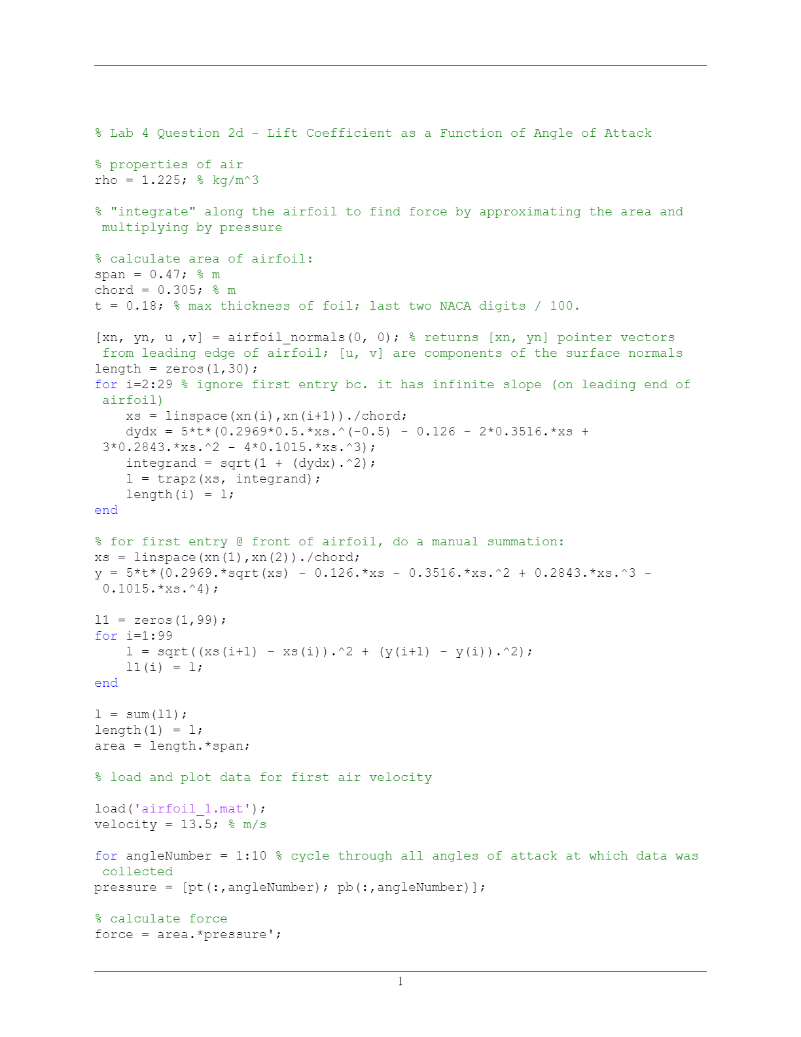
MATLAB PROJECT EXAMPLE (pg 1 of 2)
I wrote this short program for a recent Mechanics of Fluids lab, in which my group collected measurements from 30 pressure taps along a NACA 0018 airfoil at various angles of attack. The purpose of this code was to calculate the lift coefficient from the raw pressure data and plot it as a function of the angle of attack. We collected data at three separate air velocities, corresponding to the three Reynolds numbers displayed in the plot legend.
Although I wrote this program solely for myself (only the final plot was submitted), I maintained clear comments and stylistic writing throughout.

Slide 4
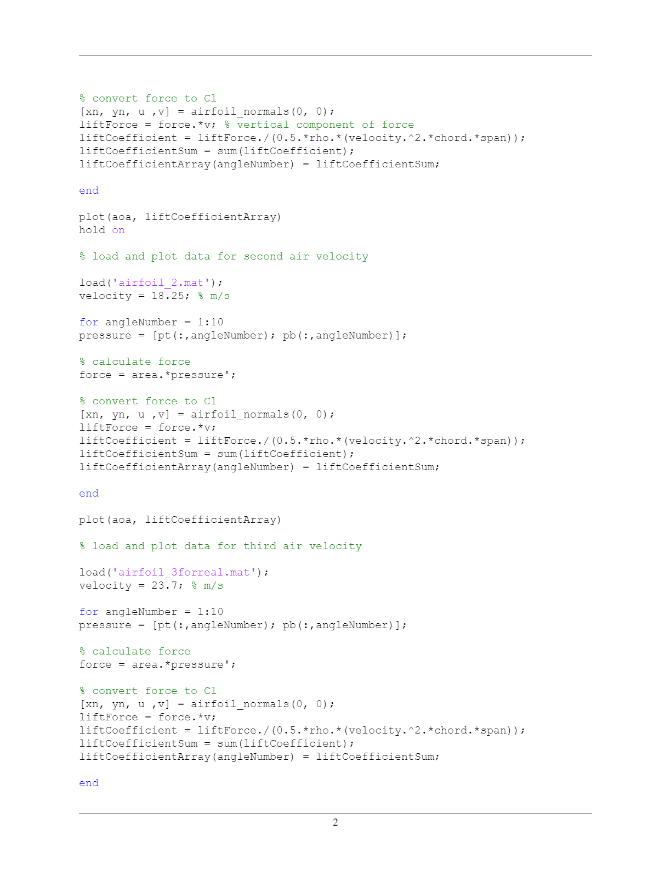
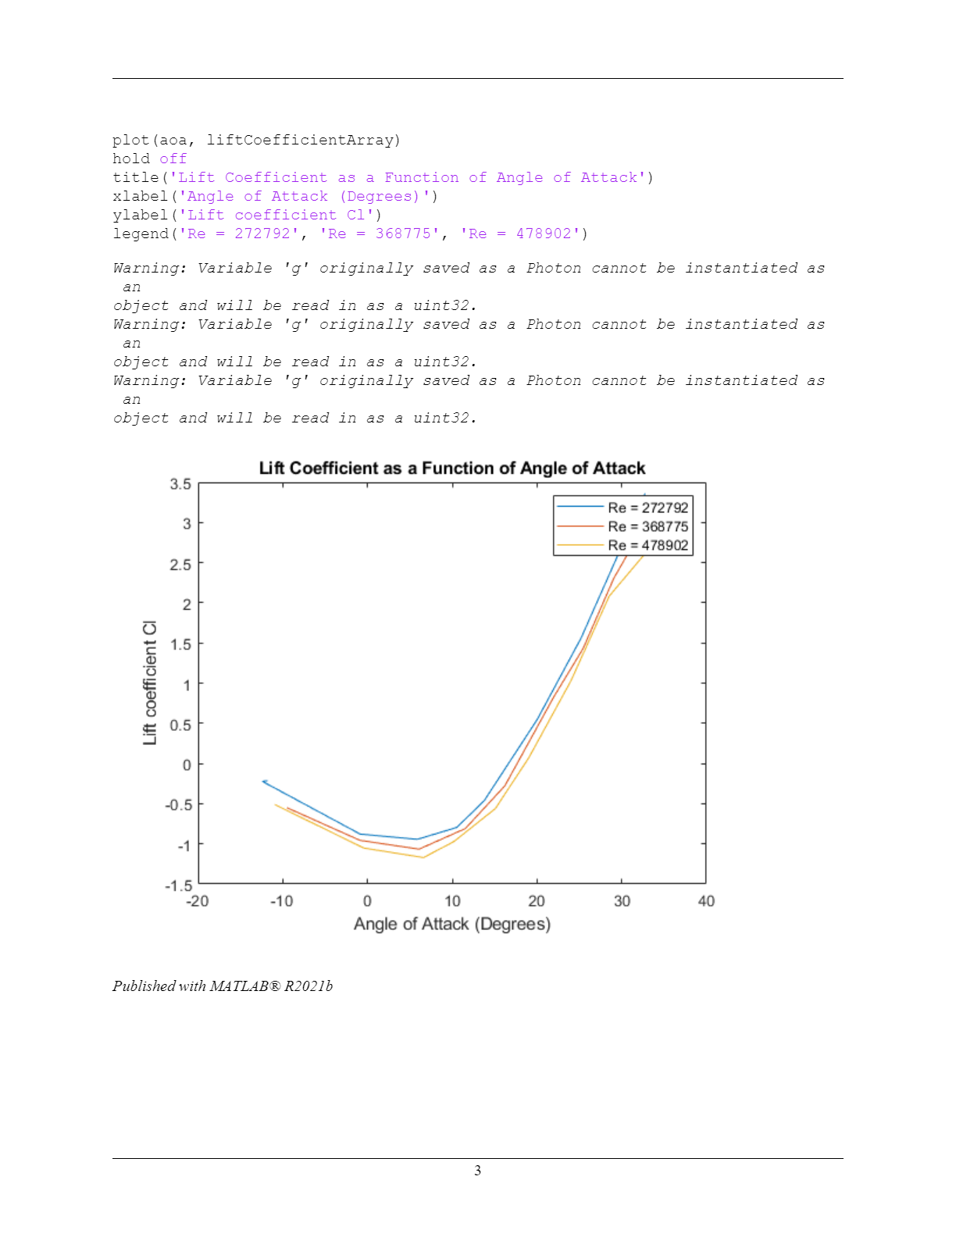
MATLAB PROJECT EXAMPLE (pg 2 of 2)

Slide 5
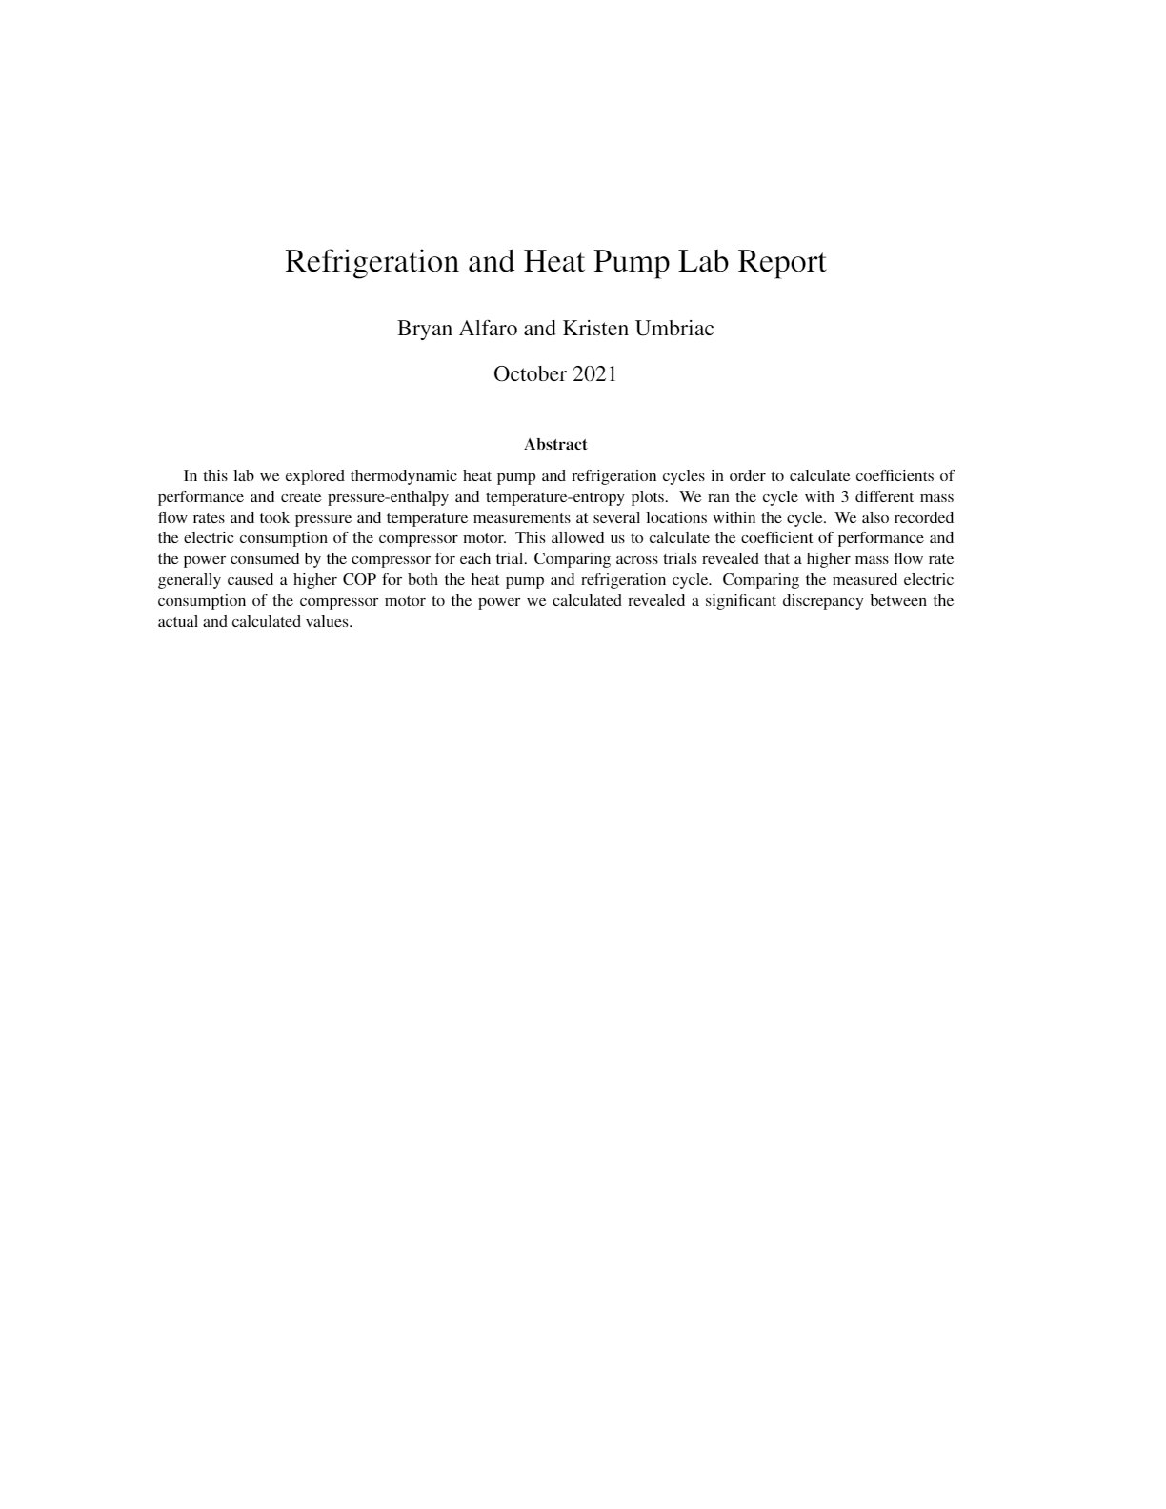
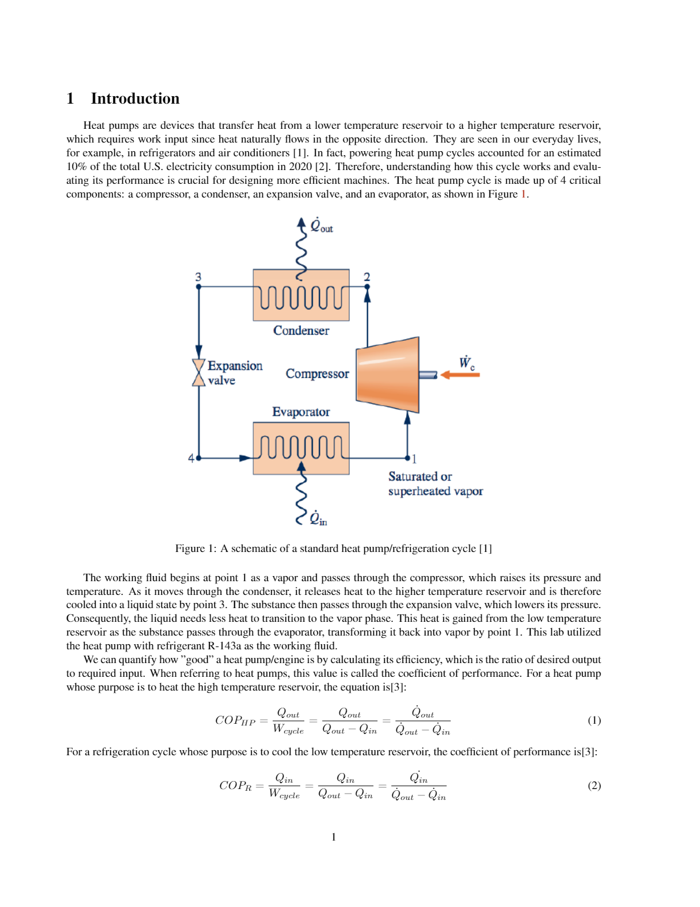
LATEX REPORT EXCERPT (pg 1 of 2)

Slide 6
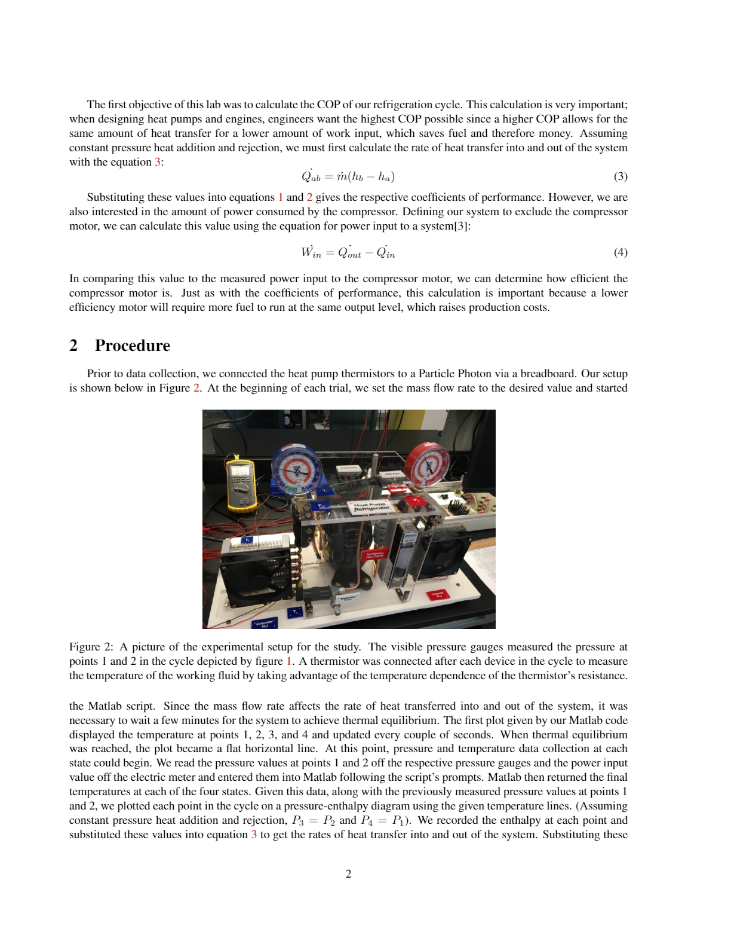
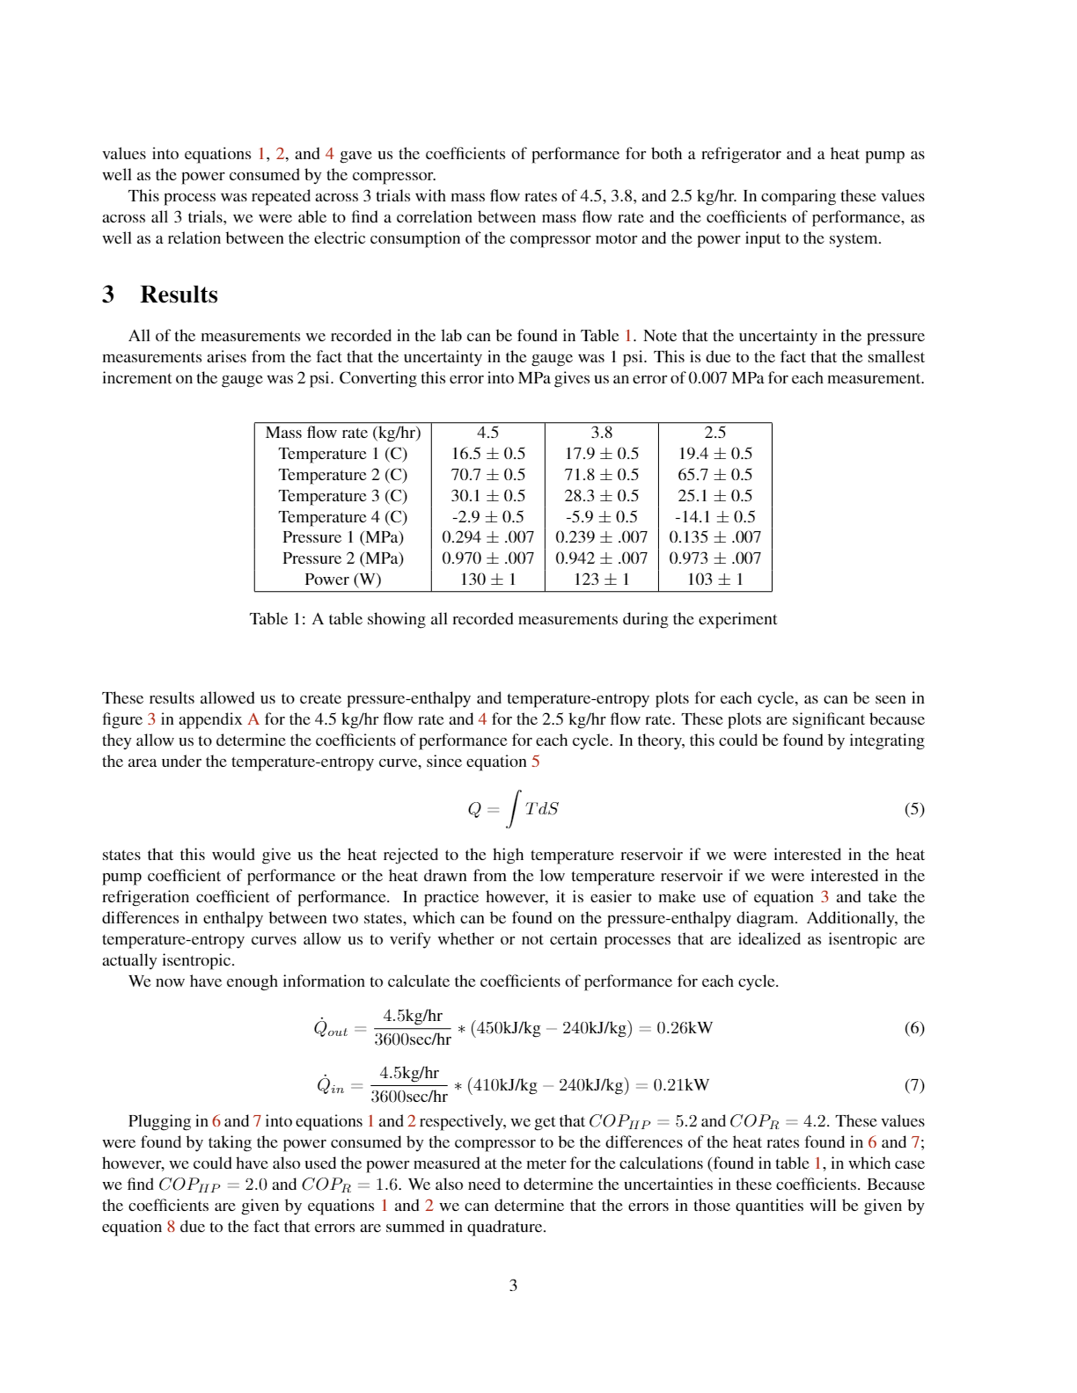
LATEX REPORT EXCERPT (pg 2 of 2)

Slide 7
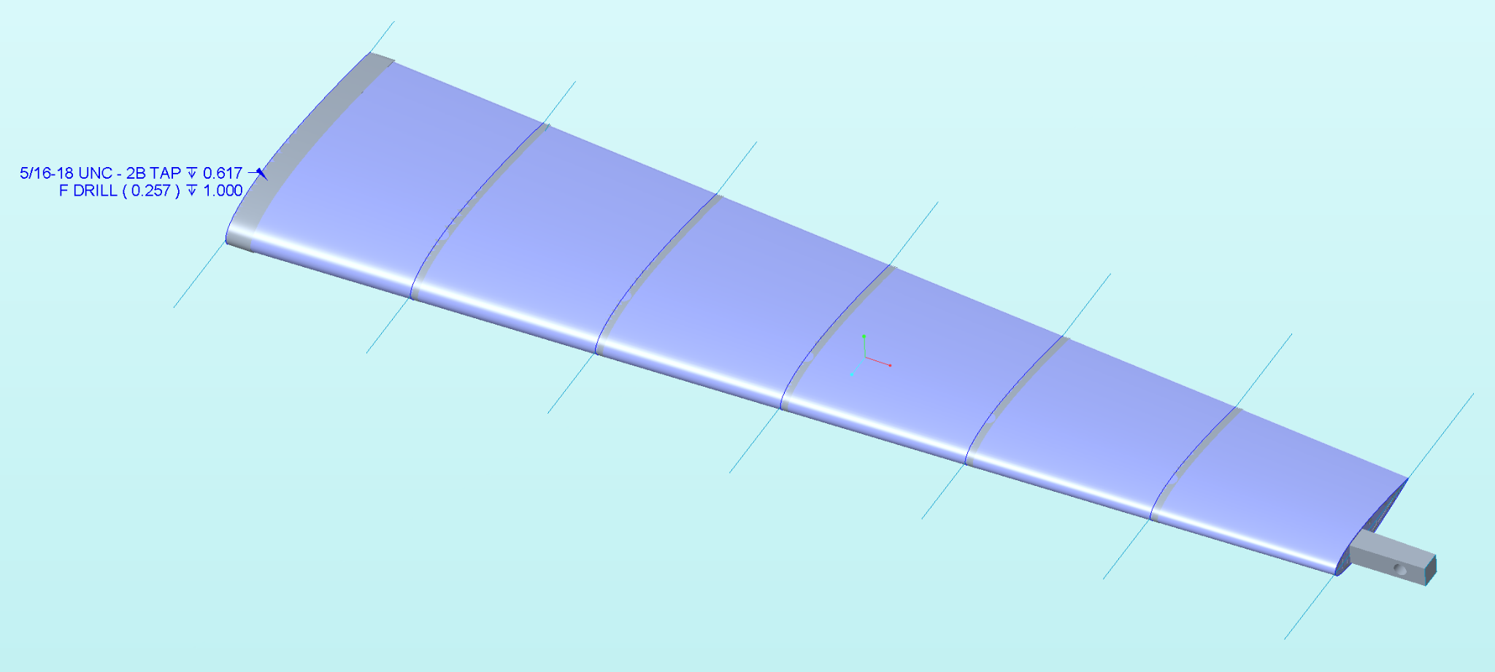
CREO CANTILEVERED WING
DESIGN GOAL
Given a 2D airfoil template, create a wing assembly containing a beam, bulkheads, and wing surface
Minimize weight while maintaining ability to support 95lb.
Load applied by threading weights through hole on end of beam
Constraints on beam length and surface area of wing
PERSONAL RESPONSIBILITIES
Design Team - Bulkheads
Assisted with beam analysis (FEA & sensitivity studies)
Spearheaded bulkhead design and placement to fit tapered beam design
Ran full assembly FEA analysis to iterate bulkhead design and decide on materials for bulkheads/wing surface
Created final bill of materials and ordered through McMaster Carr
Engineering Drawings Co-Lead
Created all bulkhead drawings and assisted with beam drawing
TEAM RESPONSIBILITIES
Design, iterate, order material for, and build full wing assembly (beam, bulkheads, and wing surface)
We designated members to Design, Engineering Drawings, and Manufacturing subteams
Create drawings for each part in the assembly
Create preliminary and final design reports as well as a bill of materials

Slide 8
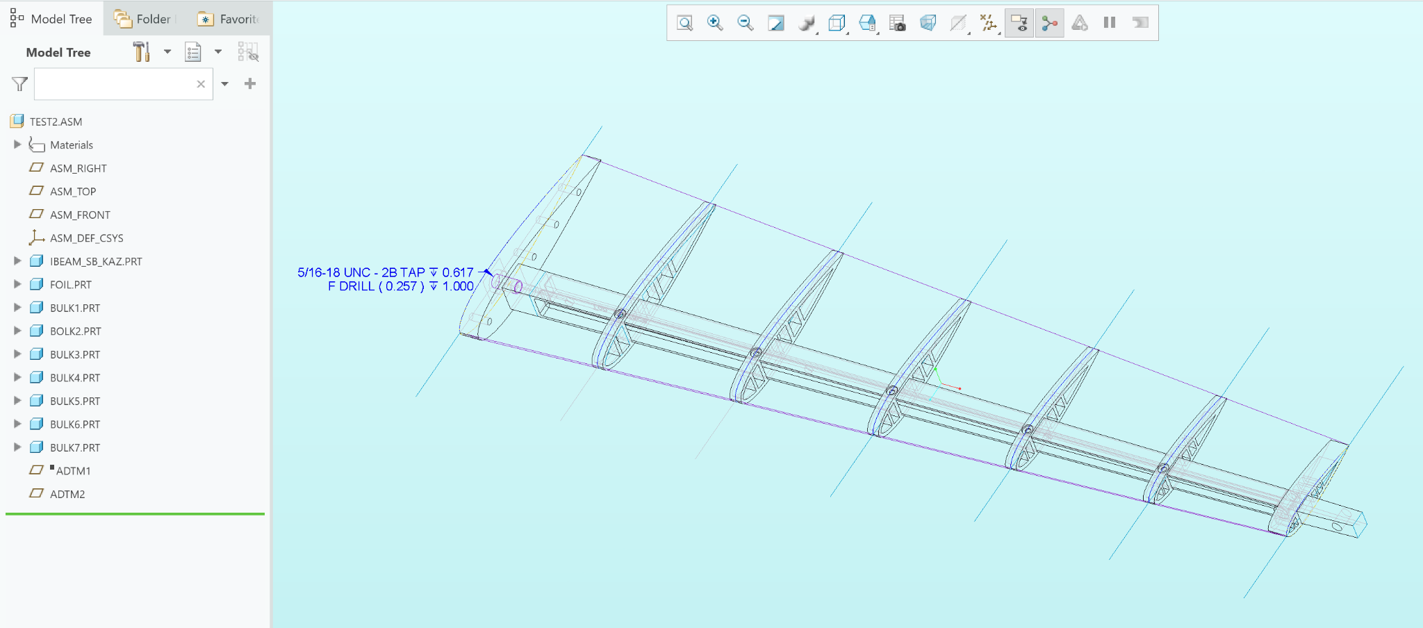
HIDDEN LINE ASSEMBLY

Slide 9
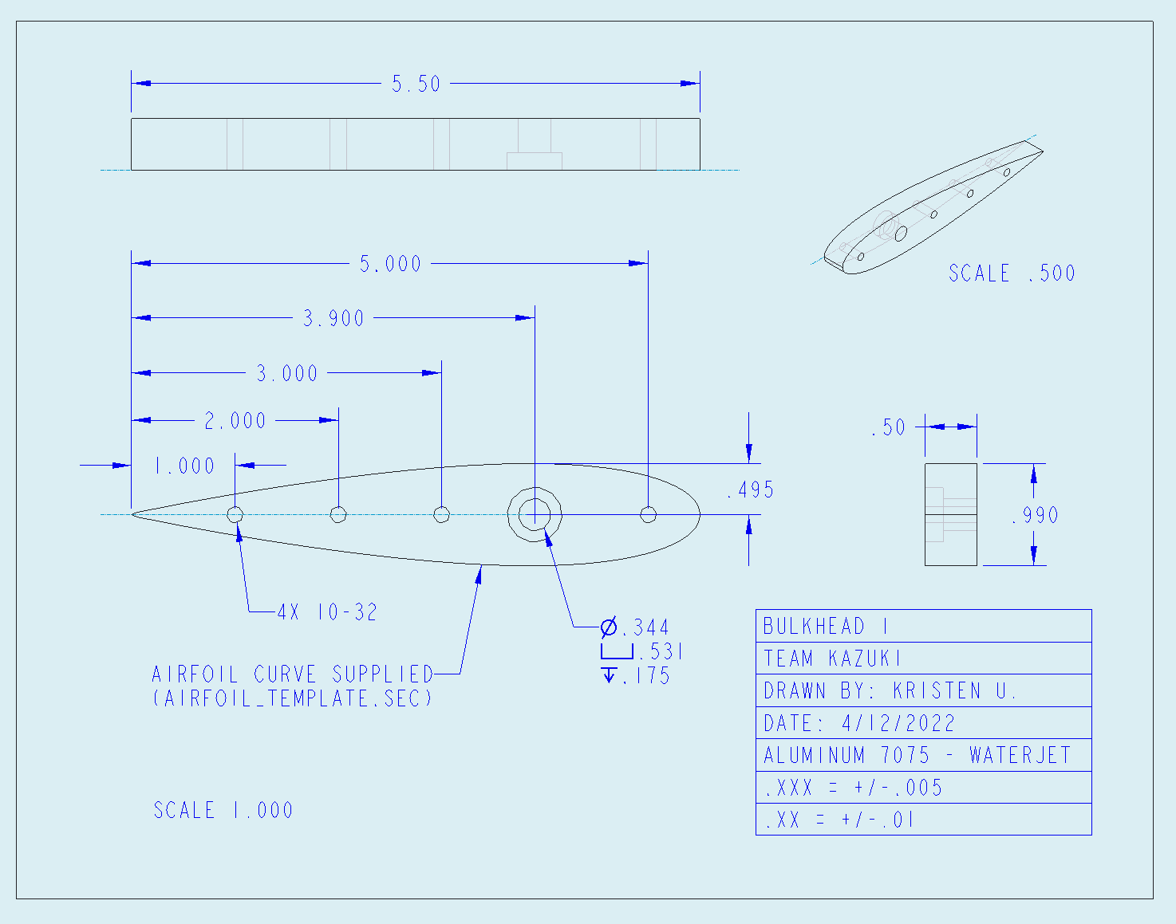
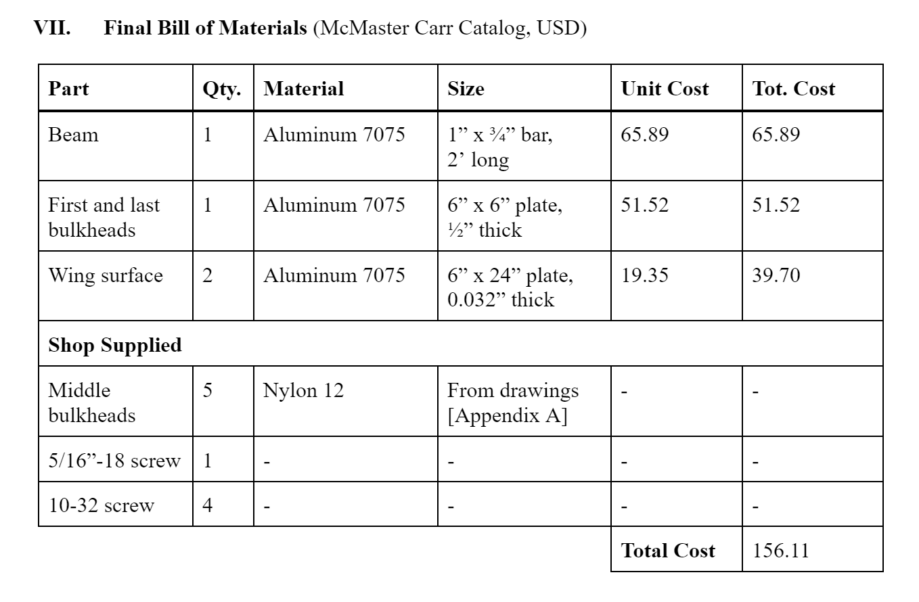
BULKHEAD DRAWING
BILL OF MATERIALS

Slide 10
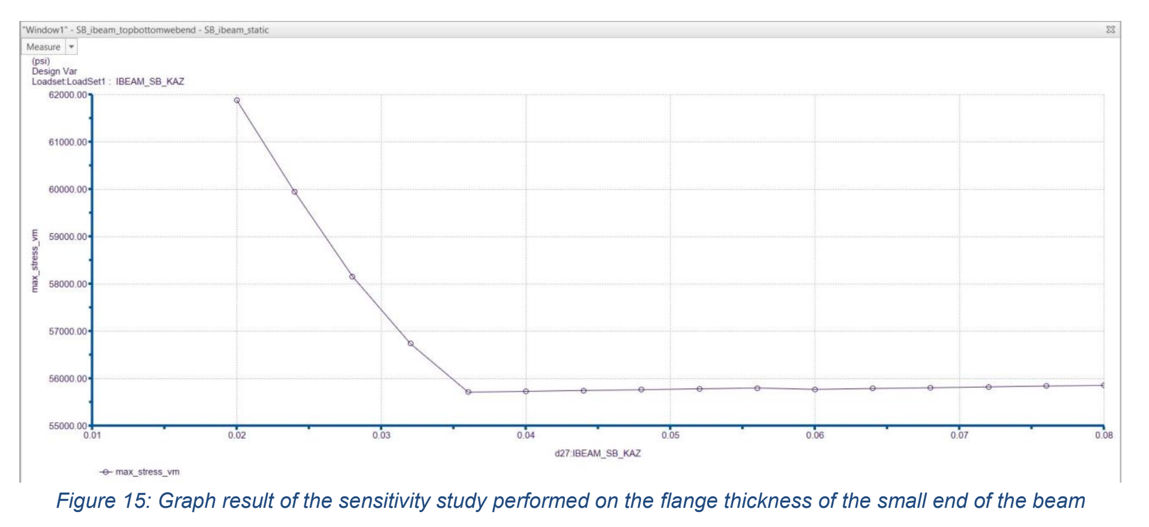
SENSITIVITY STUDIES

Slide 11
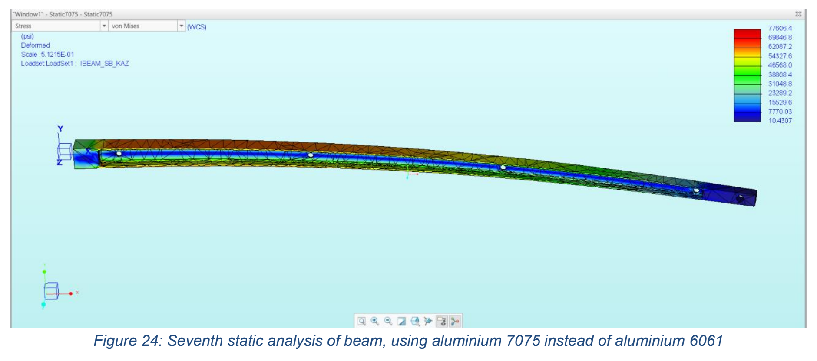
FEA

Slide 12
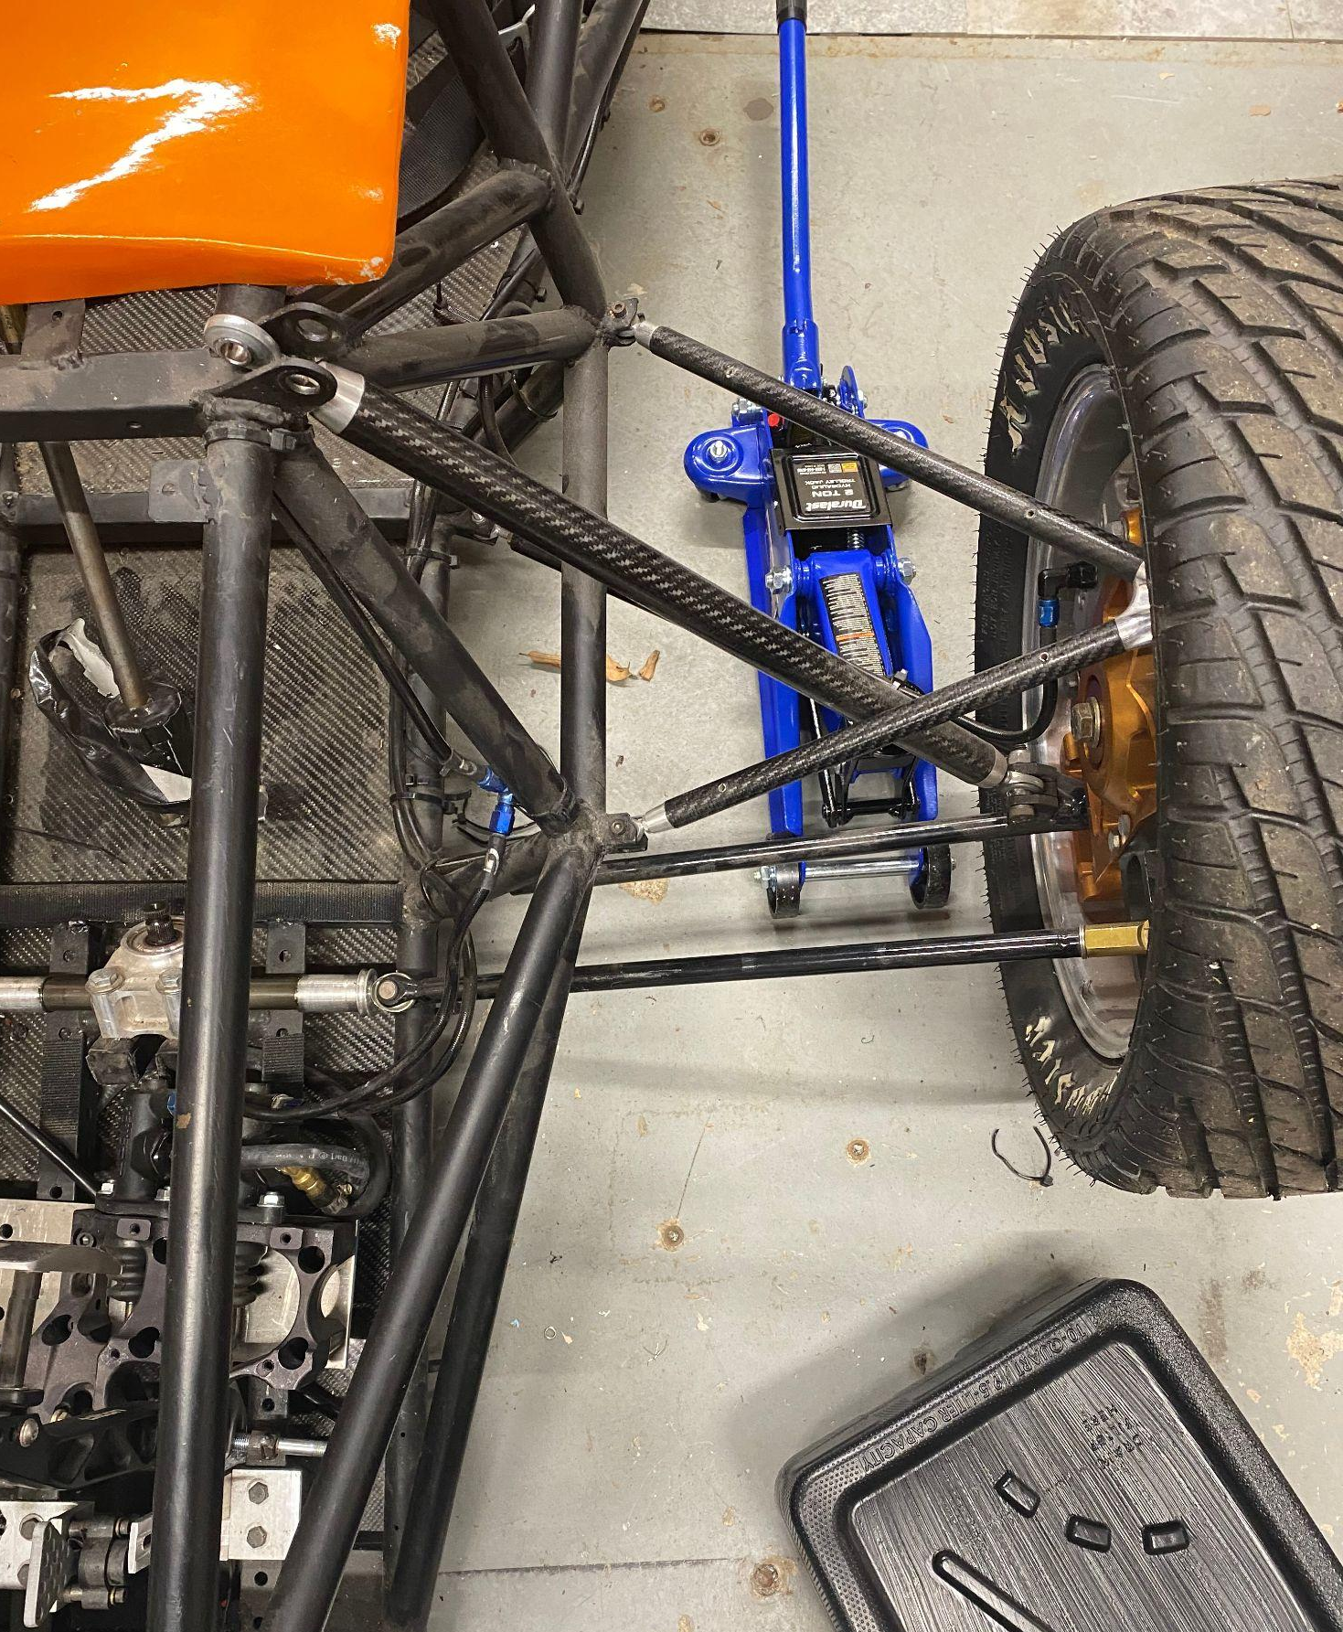
PRINCETON RACING ELECTRIC
I joined PRE at the beginning of 2022 as a member of the Suspension Team, where I performed Creo FEA analysis on tie-rod ends in order to optimize diameter. Midway through the semester I took on the role of Brake Systems Lead in order to get away from the computer and gain more hands-on experience. This role involved a strong learning curve and lots of trial-and-error in singlehandedly getting the brakes detached from the old car and fixed to the new car. Hydraulic brake systems are a niche subject, but this experience showed me firsthand the challenges of designing and manufacturing a product that integrates into a larger assembly. I learned the importance of communication across teams (Mechanical, Electrical, and Business) and the necessity of designing not only for functionality, but for assembly! (Can’t use a socket-head screw if I can’t fit a wrench in to tighten it…)
Pic taken while removing brake lines from (what’s left of) the 2020 car in order to reuse on the 2022 car

Slide 13
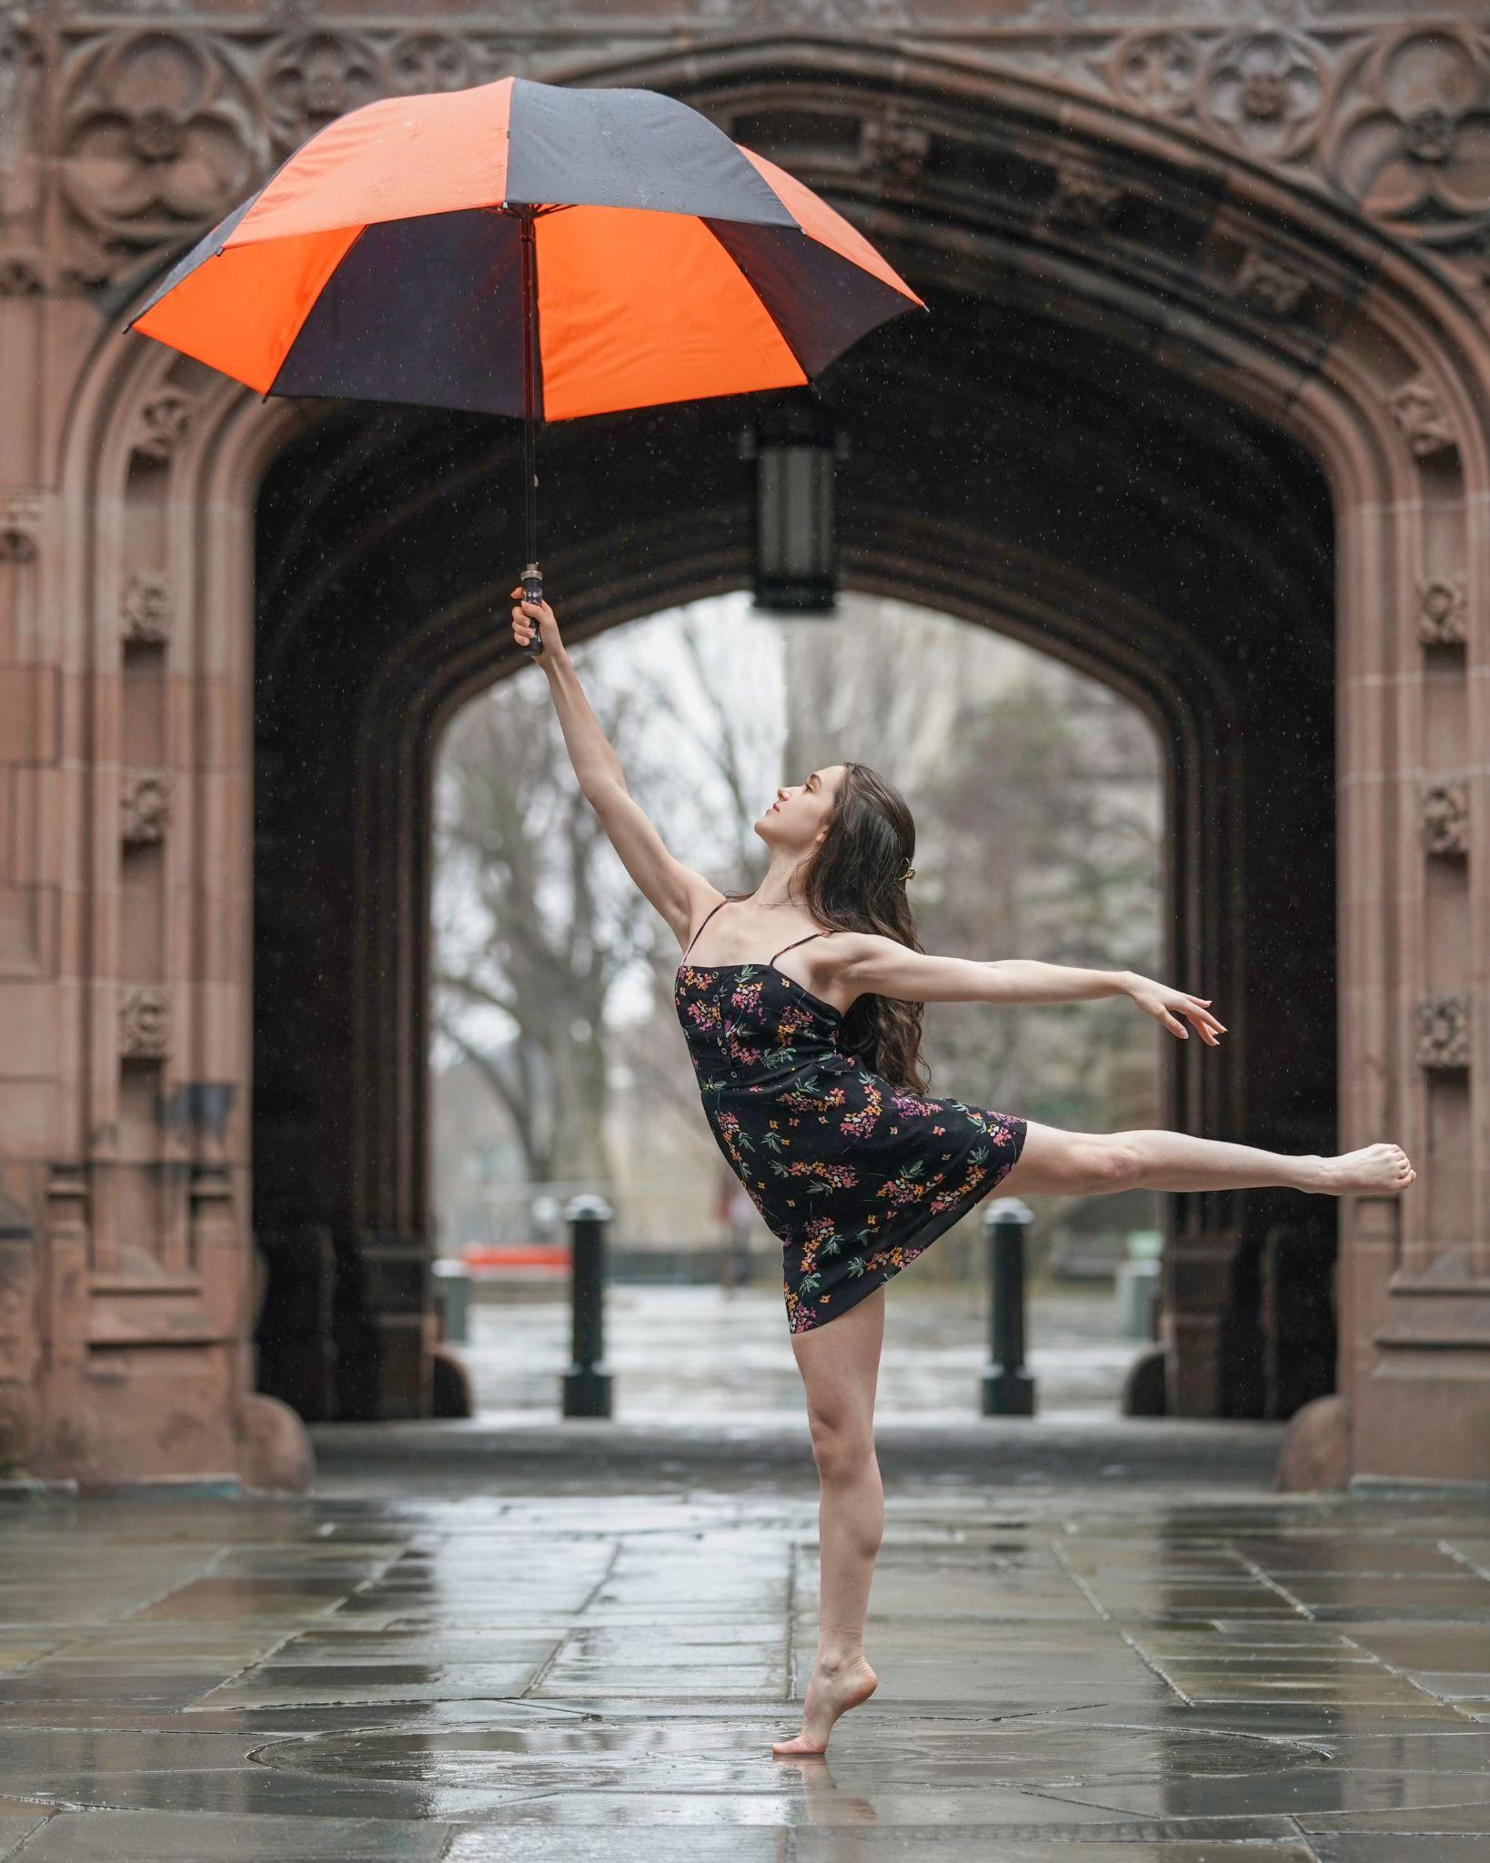
PRINCETON UNIVERSITY BALLET
Outside of academics, I spend most of my free time dancing! PUB is an entirely student-run dance company that puts on a full-length show each semester. On top of 10+ hours/week spent in company classes and rehearsals, I am the Production Manager and handle all technical aspects of our performances. This includes:
Hiring and managing technical staff (lighting, sound, stage managers, photographers, videographers)
Communicating all lighting & sound info between choreographers and technical staff
Co-running full company rehearsals before tech week
Designing program booklets (most recent one was 14 pages) and coordinating printing efforts across the company for 800+ audience members
It is truly a labor of love and something I look forward to each week!

Slide 14
CREDITS
This is where you give credit to the ones who are part of this project.
Presentation template by Slidesgo
Icons by Flaticon
Infographics by Freepik
Images created by Freepik

Slide 15


